Slide 1
Course Name: Database Systems Course Code: CS52 Credits: 3:1:0 UNIT 4 Term: October 2021 – February 2022
M.S. Ramaiah Institute of Technology
(Autonomous Institute, Affiliated to VTU)
Department of Computer Science and Engineering
Faculty:
Dr. Sini Anna Alex

Slide 2
Algorithms for Relational Database Schema Design
Relational Decomposition into BCNF with Lossless (non-additive) join property
Input: A universal relation R and a set of functional dependencies F on the attributes of R.
1. Set D := {R};
2. While there is a relation schema Q in D that is not in BCNF
do {
choose a relation schema Q in D that is not in BCNF;
find a functional dependency X  Y in Q that violates BCNF;
replace Q in D by two relation schemas (Q - Y) and (X υ Y);
};
Assumption: No null values are allowed for the join attributes.
DB(Patno,PatName,appNo,time,doctor)
Patno -> PatName Patno -> Time,doctor Time -> appNo
appNo-> Patno
2NF AND 3NF
DB(Patno,appNo,Time,doctor, PatName)
BCNF
Q=DB(Patno,appNo,Time,doctor, PatName)
Time -> appNo (X→Y, violates BCNF)
Replace Q into: Q-Y AND XUY
D1(Patno,time,doctor, PatName)
D2(Time, appNo)

Slide 3
General Procedure for achieving BCNF when a relation fails BCNF
Let R be the relation not in BCNF, let X be a subset-of R, and let X → A be the FD that causes a violation of BCNF. Then R may be decomposed into two relations:
(i) R –A and (ii) X υ A.
If either R –A or X υ A. is not in BCNF, repeat the process.
Note that the f.d. that violated BCNF in TEACH(Instructor, Student, Course)
was Instructor →Course. Hence its BCNF decomposition would be (TEACH – COURSE) and (Instructor υ Course), which gives
the relations: (Instructor, Student) and (Instructor, Course) that we obtained before in decomposition D3.

Slide 4
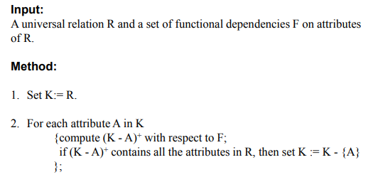
Finding a Key K for R Given a set F of Functional Dependencies
Let R = (A, B, C, D, E) be a relation scheme with the following dependencies-
AB → C
C → D
B → E

Slide 5
Algorithms for Relational Database Schema Design
Relational Synthesis into 3NF with Dependency Preservation and Lossless (Non-Additive) Join Property
Input: A universal relation R and a set of functional dependencies F on the attributes of R.
1. Find a minimal cover G for F.
2. For each left-hand-side X of a functional dependency that appears in G,
create a relation schema in D with attributes {X υ {A1} υ {A2} ... υ {Ak}},
where X  A1, X  A2, ..., X –>Ak are the only dependencies in G with X as left-hand-side (X is the key of this relation).
3. If none of the relation schemas in D contains a key of R, then create one more relation schema in D that contains attributes that form a key of R. (Use Algorithm to find the key of R)
4. Eliminate redundant relations from the resulting set of relations in the relational database schema.

Slide 6
Example
FD:
{P→LCA, LC→AP, A→C}
Minimal Cover: P→LC,LC→AP, A→C
Design X: R1(P,L,C), R2(L,C, A, P) and R3(A,C)
R3 is subsumed by R2, R1 by R2 //eliminating redundant relations
Final Design: R2(L,C,A,P)
F: {P→LCA, LC→AP, A→C}
LC→P , P→A => LC→A
P→A , A→C => P→C
MC:{P→LA, LC→P, A->C}
Alternate Design: S1(P,A,L),S2(L,C,P) AND S3(A,C)

Slide 7
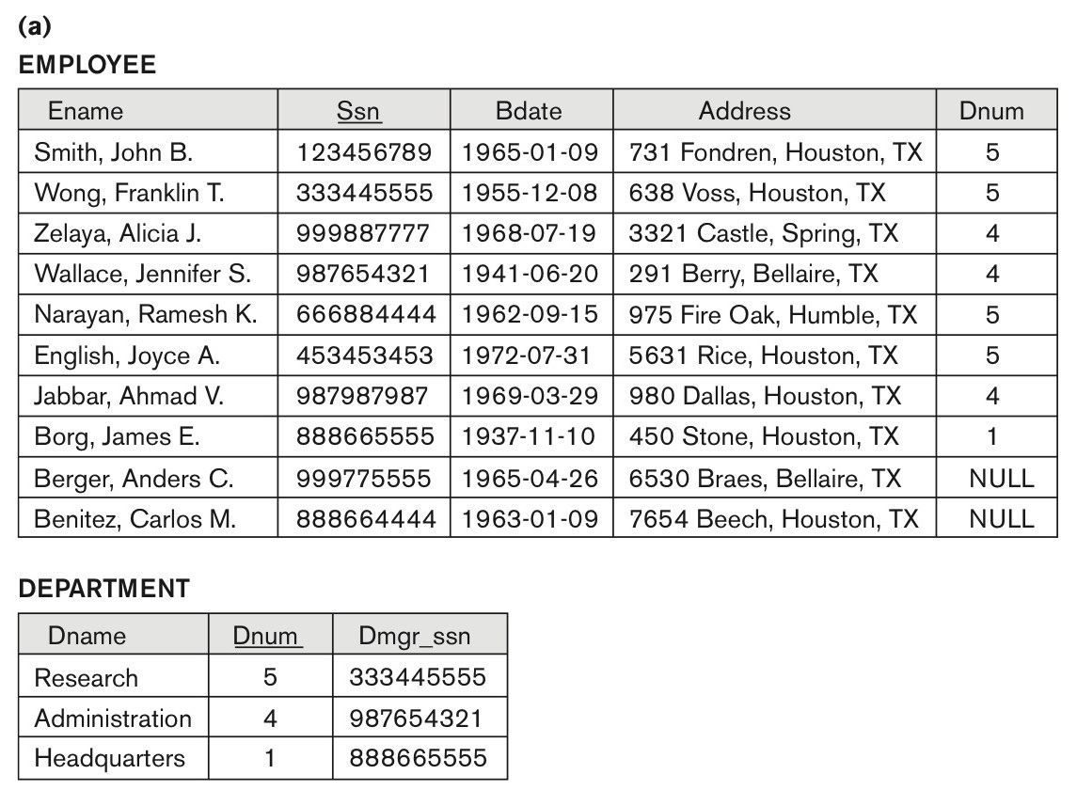
Problems with NULL values and Dangling Tuples
Problems with NULL values
when some tuples have NULL values for attributes that will be used to join individual relations in the decomposition that may lead to incomplete results.
E.g., see Figure 15.2(a), where two relations EMPLOYEE and DEPARTMENT are shown. The last two employee tuples—‘Berger’ and ‘Benitez’—represent newly hired employees who have not yet been assigned to a department (assume that this does not violate any integrity constraints).
If we want to retrieve a list of (Ename, Dname) values for all the employees. If we apply the NATURAL JOIN operation on EMPLOYEE and DEPARTMENT (Figure 15.2(b)), the two aforementioned tuples will not appear in the result.
In such cases, LEFT OUTER JOIN may be used. The result is shown in Figure 15.2 (c).
Figure 15.2
Issues with NULL-value joins. (a) Some EMPLOYEE tuples have NULL for the join attribute Dnum.

Slide 8
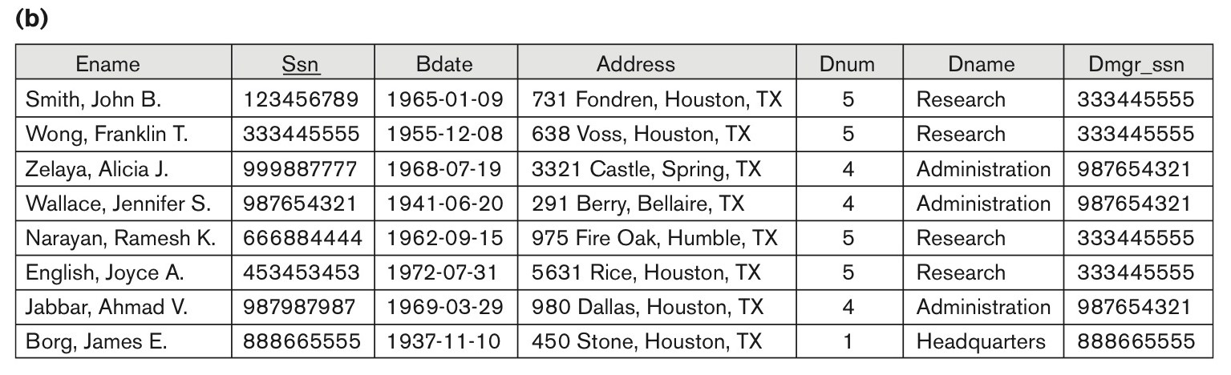
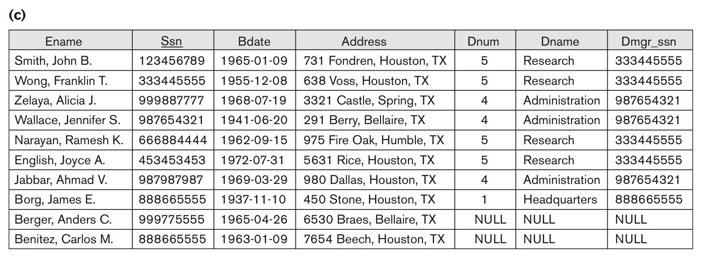
Problems with Null Values and Dangling Tuples
Figure 15.2
Issues with NULL-value joins.
(b) Result of applying NATURAL JOIN to the EMPLOYEE and DEPARTMENT relations.
(c) Result of applying LEFT OUTER JOIN to EMPLOYEE and DEPARTMENT

Slide 9
About Normalization Algorithms
Discussion of Normalization Algorithms:
Problems:
The database designer must first specify all the relevant functional dependencies among the database attributes.
These algorithms are not deterministic in general.
It is not always possible to find a decomposition into relation schemas that preserves dependencies and allows each relation schema in the decomposition to be in BCNF.

Slide 10
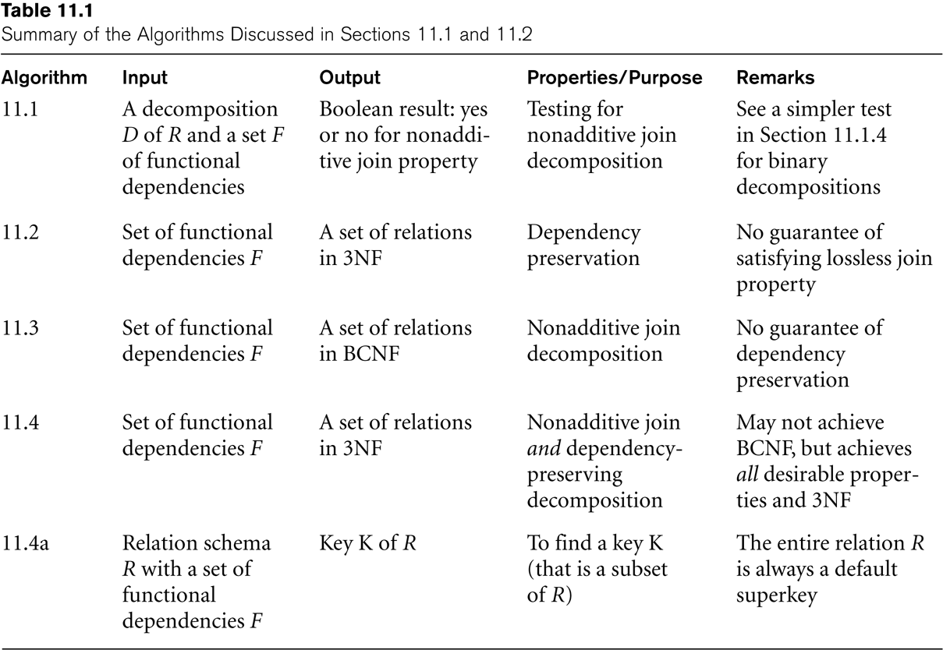
Algorithms for Relational Database Schema Design

Slide 11
Multivalued Dependencies and Fourth Normal Form
Definition:
A multivalued dependency (MVD) X —>> Y specified on relation schema R, where X and Y are both subsets of R, specifies the following constraint on any relation state r of R: If two tuples t₁ and t₂ exist in r such that t₁[X] = t₂[X], then two tuples t₃ and t₄ should also exist in r with the following properties, where we use Z to denote (R 2 (X υ Y)):
t₃[X] = t₄[X] = t₁[X] = t₂[X].
t₃[Y] = t₁[Y] and t₄[Y] = t₂[Y].
t₃[Z] = t₂[Z] and t₄[Z] = t₁[Z].
An MVD X —>> Y in R is called a trivial MVD if (a) Y is a subset of X, or (b) X υ Y = R.

Slide 12
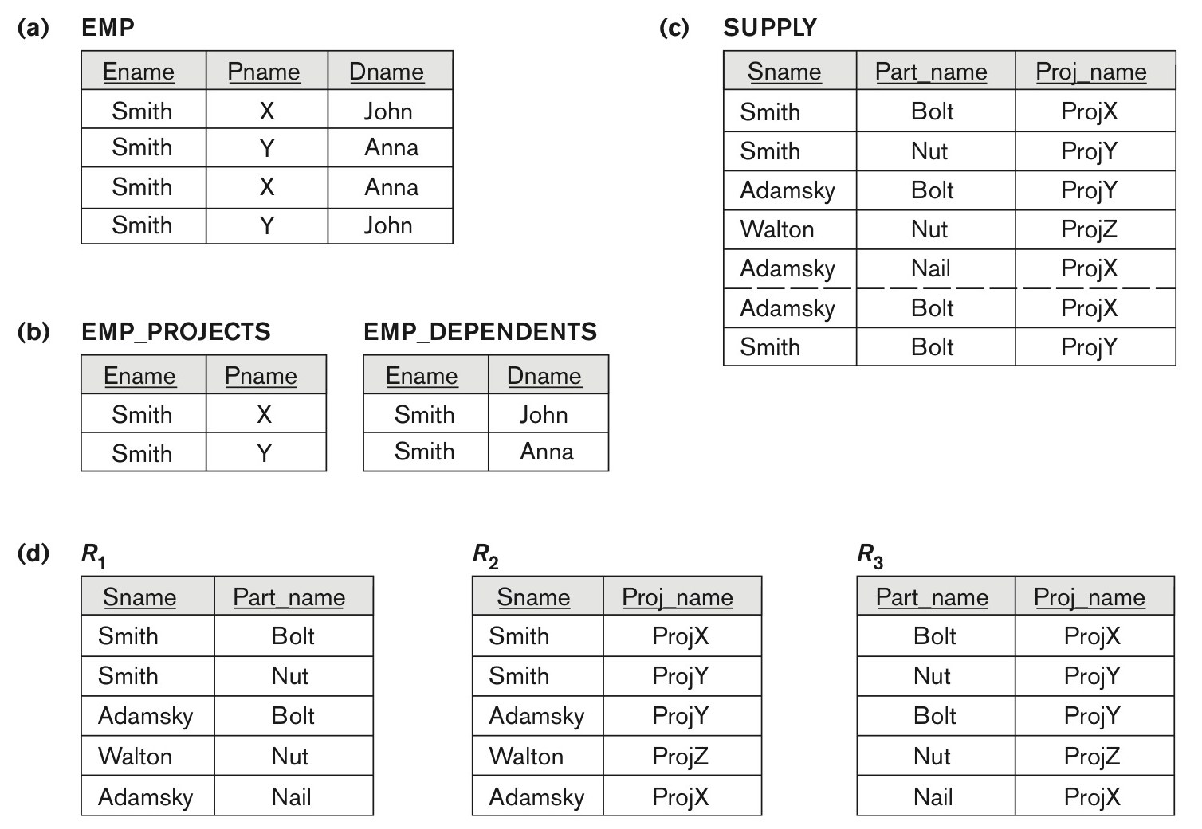
Fourth normal forms
Fourth normal forms. (a) The EMP relation with two MVDs: Ename –>> Pname and Ename –>> Dname. (b) Decomposing the EMP relation into two 4NF relations EMP_PROJECTS and EMP_DEPENDENTS. (c) The relation SUPPLY with no MVDs is in 4NF but not in 5NF if it has the JD(R1, R2, R3). (d) Decomposing the relation SUPPLY into the 5NF relations R1, R2, R3.

Slide 13
Multivalued Dependencies and Fourth Normal Form
Definition:
A relation schema R is in 4NF with respect to a set of dependencies F (that includes functional dependencies and multivalued dependencies) if, for every nontrivial multivalued dependency X —>> Y in F⁺, X is a superkey for R.
Note: F⁺ is the (complete) set of all dependencies (functional or multivalued) that will hold in every relation state r of R that satisfies F. It is also called the closure of F.

Slide 14
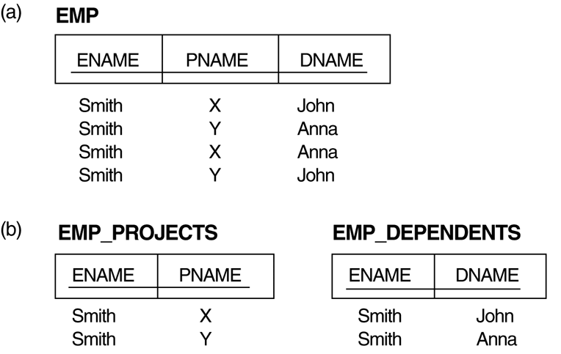
Multivalued Dependencies and Fourth Normal Form
The EMP relation with two MVDs: ENAME —>> PNAME and ENAME —>> DNAME.
Decomposing the EMP relation into two 4NF relations EMP_PROJECTS and EMP_DEPENDENTS.

Slide 15
Multivalued Dependencies and Fourth Normal Form
Inference Rules for Functional and Multivalued Dependencies:
IR1 (reflexive rule for FDs): If X ⊇ Y, then X –> Y.
IR2 (augmentation rule for FDs): {X –> Y} ⏐= XZ –> YZ.
IR3 (transitive rule for FDs): {X –> Y, Y –>Z} ⏐= X –> Z.
IR4 (complementation rule for MVDs): {X —>> Y}⏐=X—>> (R – (X ∪ Y))}.
IR5 (augmentation rule for MVDs): If X —>> Y and W ⊇ Z then WX —>> YZ.
IR6 (transitive rule for MVDs): {X —>> Y, Y —>> Z} ⏐= X —>> (Z 2 Y).
IR7 (replication rule for FD to MVD): {X –> Y} ⏐= X —>> Y.
IR8 (coalescence rule for FDs and MVDs): If X —>> Y and there exists W with the properties that
(a) W ∩ Y is empty, (b) W –> Z, and (c) Y ⊇ Z, then X –> Z.

Slide 16
Multivalued Dependencies and Fourth Normal Form
Lossless (Non-additive) Join Decomposition into 4NF Relations:
PROPERTY LJ1’
The relation schemas R₁ and R₂ form a lossless (non-additive) join decomposition of R with respect to a set F of functional and multivalued dependencies if and only if
(R₁ ∩ R₂) —>> (R₁ - R₂)
or by symmetry, if and only if
(R₁ ∩ R₂) —>> (R₂ - R₁)).

Slide 17
Multivalued Dependencies and Fourth Normal Form
Relational decomposition into 4NF relations with non-additive join property
Input: A universal relation R and a set of functional and multivalued dependencies F.
Set D := { R };
While there is a relation schema Q in D that is not in 4NF do {
choose a relation schema Q in D that is not in 4NF;
find a nontrivial MVD X —>> Y in Q that violates 4NF;
replace Q in D by two relation schemas (Q - Y) and (X υ Y);
};

Slide 18
Join Dependencies and Fifth Normal Form
Definition:
A join dependency (JD), denoted by JD(R₁, R₂, ..., R_{n}), specified on relation schema R, specifies a constraint on the states r of R.
The constraint states that every legal state r of R should have a non-additive join decomposition into R₁, R₂, ..., R_{n}; that is, for every such r we have
* (π_{R1}(r), π_{R2}(r), ..., π_{Rn}(r)) = r
Note: an MVD is a special case of a JD where n = 2.
A join dependency JD(R₁, R₂, ..., R_{n}), specified on relation schema R, is a trivial JD if one of the relation schemas R_{i} in JD(R₁, R₂, ..., R_{n}) is equal to R.

Slide 19
Join Dependencies and Fifth Normal Form
Definition:
A relation schema R is in fifth normal form (5NF) (or Project-Join Normal Form (PJNF)) with respect to a set F of functional, multivalued, and join dependencies if,
for every nontrivial join dependency JD(R₁, R₂, ..., R_{n}) in F⁺ (that is, implied by F),
every R_{i} is a superkey of R.

Slide 20
Thank you

